Slide 1
Understanding & Evaluating WebAssembly Technologies for Serverless Computing
M Ali Ashraf Mohammad
Lawrence Wang

Slide 2
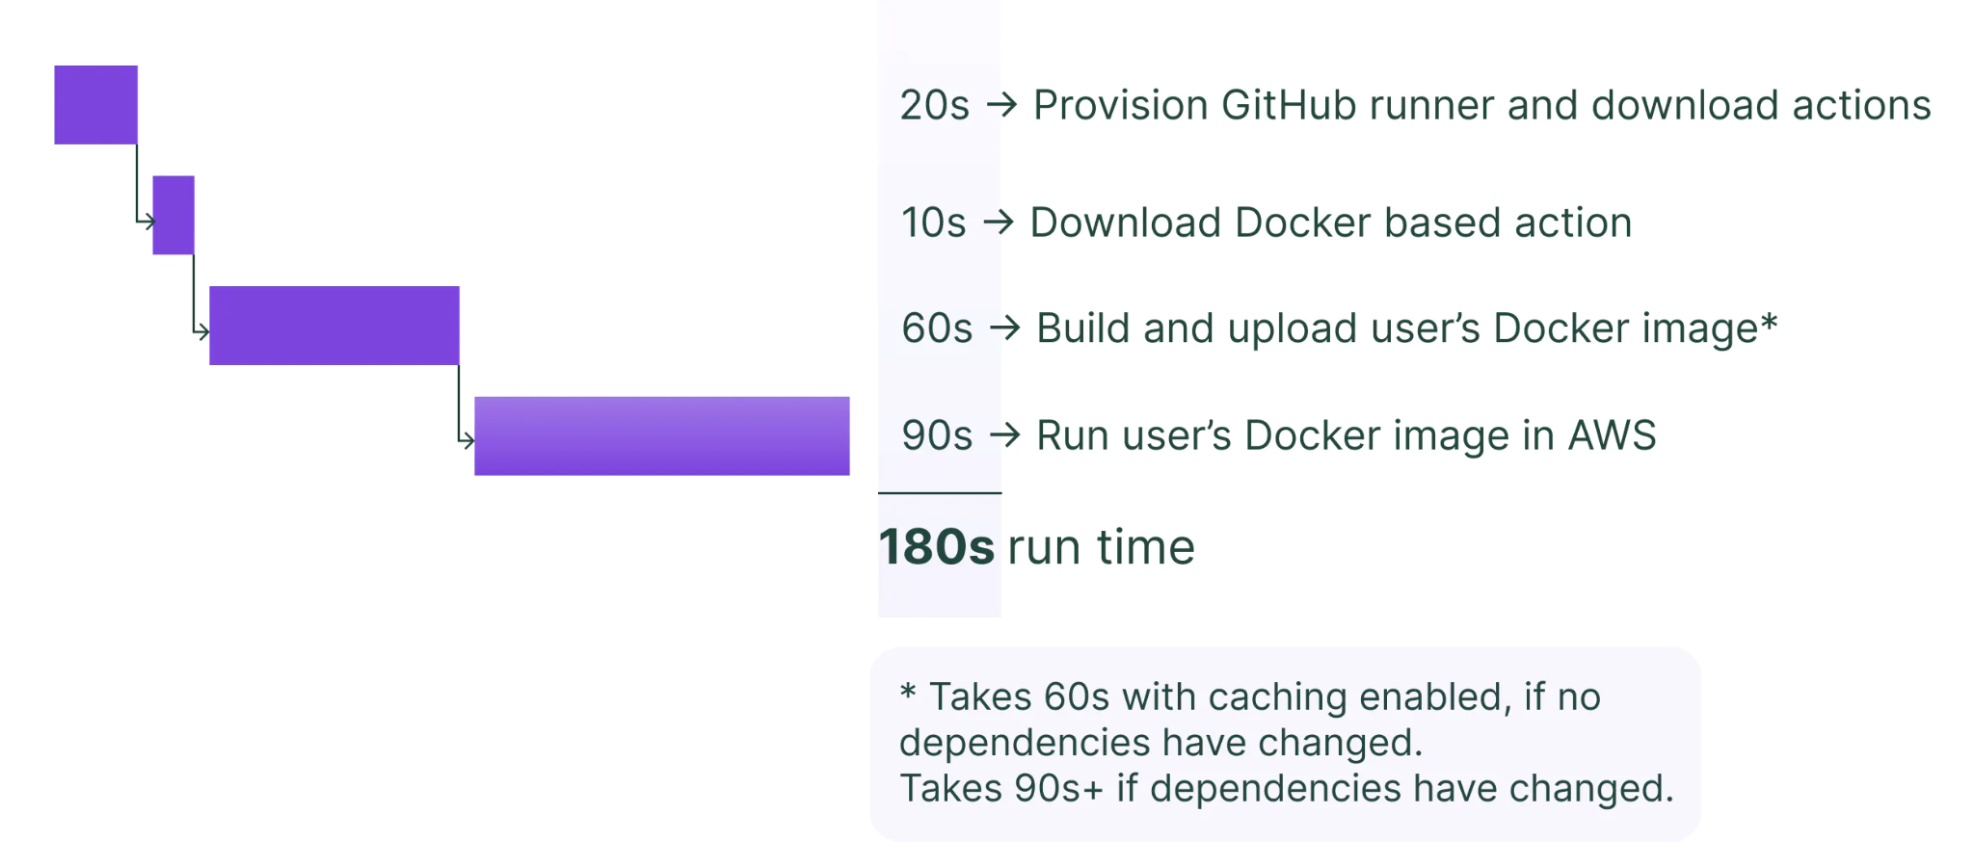
Motivations and Background
https://dagster.io/blog/fast-deploys-with-pex-and-docker

Slide 3
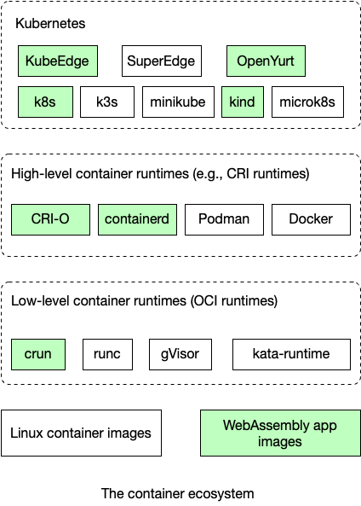
WebAssembly vs Containers
Optimizing serverless platforms is a balancing act
Wasm is limited in functionality but can use containers to help
Key takeaway: running Wasm runtimes inside of containers is good idea
https://wasmedge.org/book/en/use_cases/kubernetes.html

Slide 4
Experiment Setup
Environment: Cloudlab (x86_64/32-bit, 64-bit/UBUNTU 20.04 40 logical processors: Intel Xenon E5-2660 v2 @ 2.20 GHz)
Workers Cores (No of workers) : 1 to 32
(Sledge) Workers thread Idle loop Pause: true (sleep)/false (poll)
Apache benchmark Requests: 150K and varied concurrency
Functions tested:
No-op (Do nothing)
Fibonacci of 25 (Compute Intensive)
Html 720KB (Network data intensive)

Slide 5
Benchmarking Framework
Performed mostly using bash script, python scripts.
Node 1 : Run the setup script for sledge/wasm environment.
Node 2 : Benchmark host, sends requests and synchronizes outputs.
We use Apache Benchmark to sending the requests to node1, and we running 3 ab clients to avoid any ab client bottlenecks.
core_counts=(1 4 6 8 16 32)
Concurrency_start=2
Concurrency_stop=1024, increments-double

Slide 6
Monitor.sh
pidof to get process id using a process name.
Capture cpu usage using top cmd, and awk to extract and format
Captures virtual memory,physical memory usage using pmap cmd, and awk to extract it.
Benchmark.sh
Source benchmark helper
Set apps - Fibonacci, Noop, Html
Set number of cores/Workers
Set connections/concurrency
Save the monitor output as csv on node1, use ssh/scp to transfer over the files
Plot the Graphs on data
Benchmark_helper.sh
Contains implementation/functions to start/stop Wasm runtime, start/stop CPU/Mem monitoring, compute min/max/average of CPU/Mem, call Python graphing scripts

Slide 7
Sledge
Isolation (via Wasm sandboxing)
Supports AOT compilation
Supports C/C++/Rust/JavaScript language (Polyglot)
No support yet for multiple node orchestration

Slide 8
FAASM
Allow memory sharing among co-located functions running in a thread.
Resource isolation (process Isolation, Function signature verification)
Lots of boilerplate code to support state management
Multi-Tenancy: designed to support multi-tenancy, which means that multiple users or organizations can use the platform concurrently without interfering with each other.

Slide 9
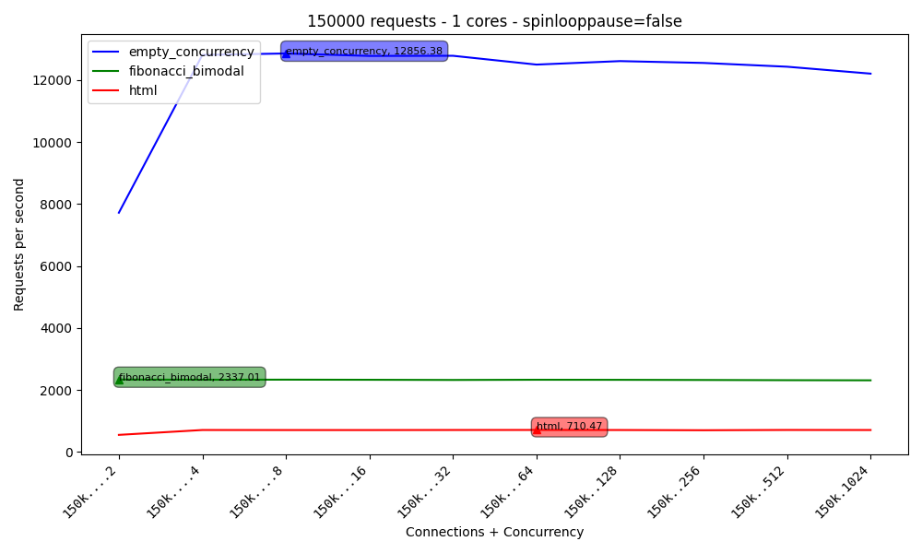
SLEDGE 1 core

Slide 10
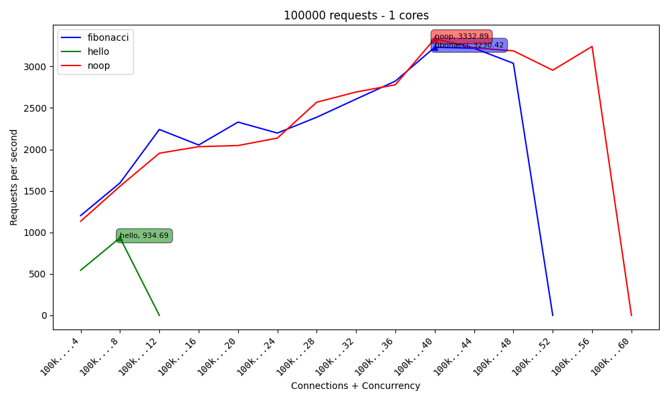
FAASM 1 core

Slide 11
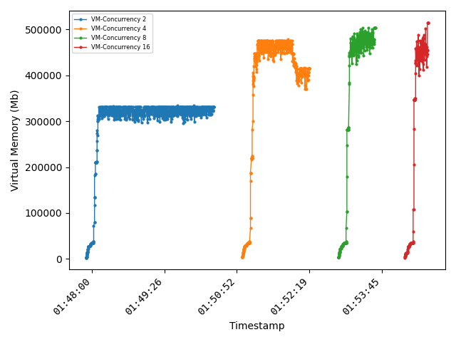
Resource Usage
Faasm uses a lot of virtual memory while executing, to avoid memory bound checking
However, the garbage collection post-execution take time (> 1 minute)

Slide 12
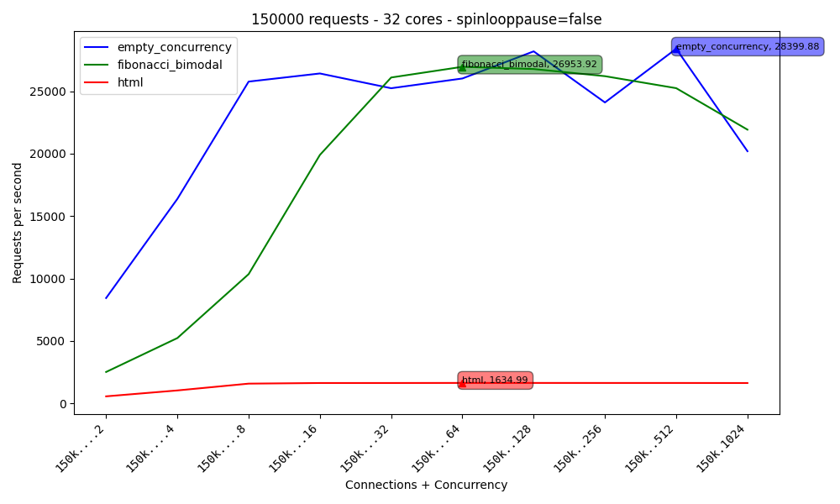
SLEDGE 32 cores

Slide 13
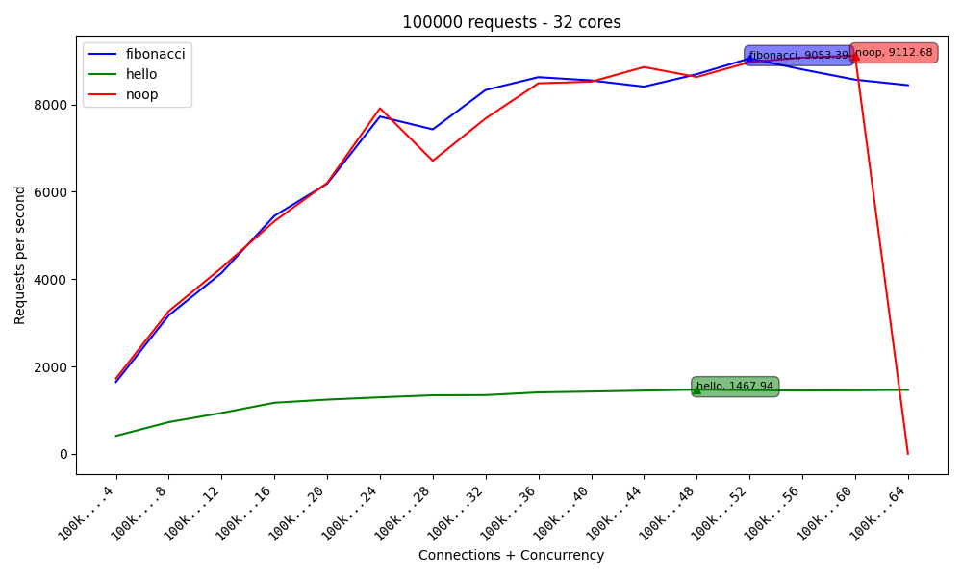
FAASM 32 cores

Slide 14
Sledge
Cold start time 0.15 - 0.2 seconds
Warm start time 0.1 - 0.15 seconds
Sledge uses a number of optimizations to minimize cold start latency, including preloading Wasm modules, using a JIT compiler to reduce the time required to generate native code, and minimizing the amount of initialization required before a function can start executing

Slide 15
FAASM
Crashing issues when concurrency is above ~16
Potential resource issues leads to Faasm crashes.
Cold start time 0.2 - 0.5 seconds
Warm start time 0.01 - 0.03 seconds

Slide 16
Future Directions
Benchmarking can be improved by using industry standard workloads to see difficult of porting applications/deps
Compare with Knative, WasmEdge (Abhishek)

Slide 17
Conclusions
Sledge is much more stable and has better potential
Theoretically suitable for running application, However, in practice it crashes at higher concurrency. WASM for serverless:
Has potential but very immature
Framework scaling and orchestration issues
No implementation standards

Slide 18
Questions?

